Slide 1

Intro to Power BI
Pizza Course
Kymo Slager
Tiaravanni Hermawan
Geoff Zimmel
Naam Achternaam

Slide 2

Getting to know you…
Mentimeter
https://www.menti.com/wyut8xdmpp

Slide 3
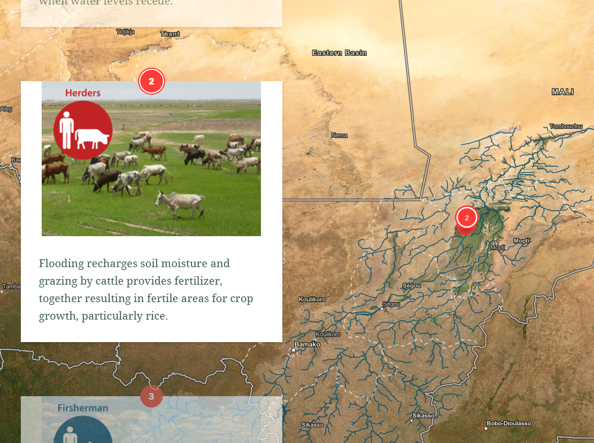
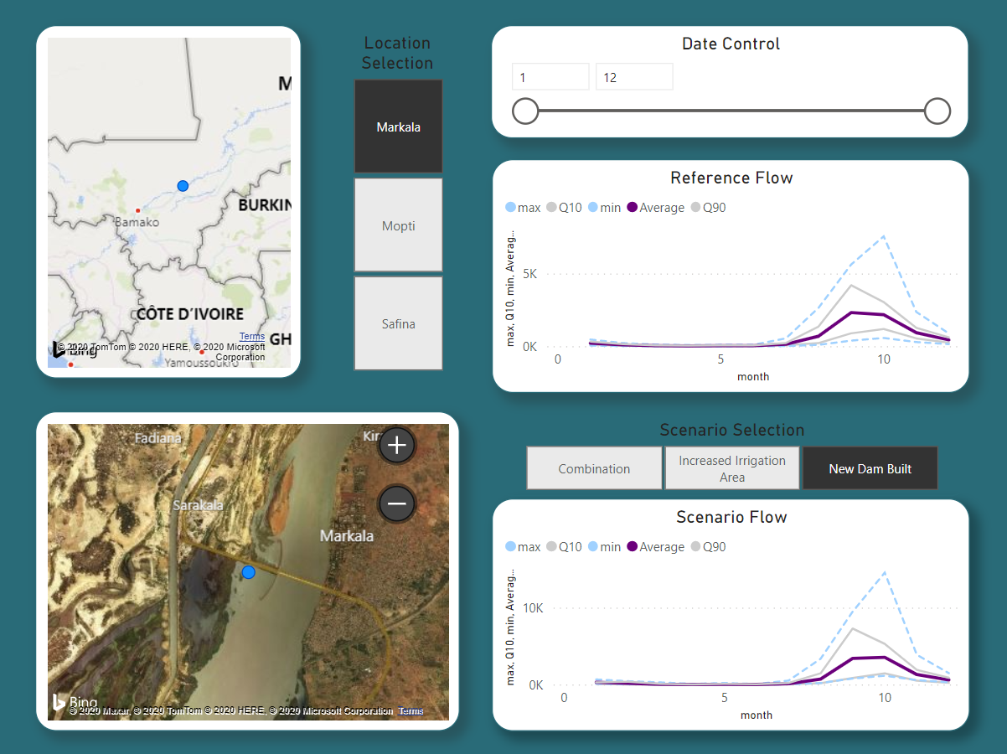
Example: Power Bi & ESRI storyboard
Tell your story & include the data
https://storymaps.arcgis.com/stories/fe8d45e9138a474c98cdce714a22ea59

Slide 4

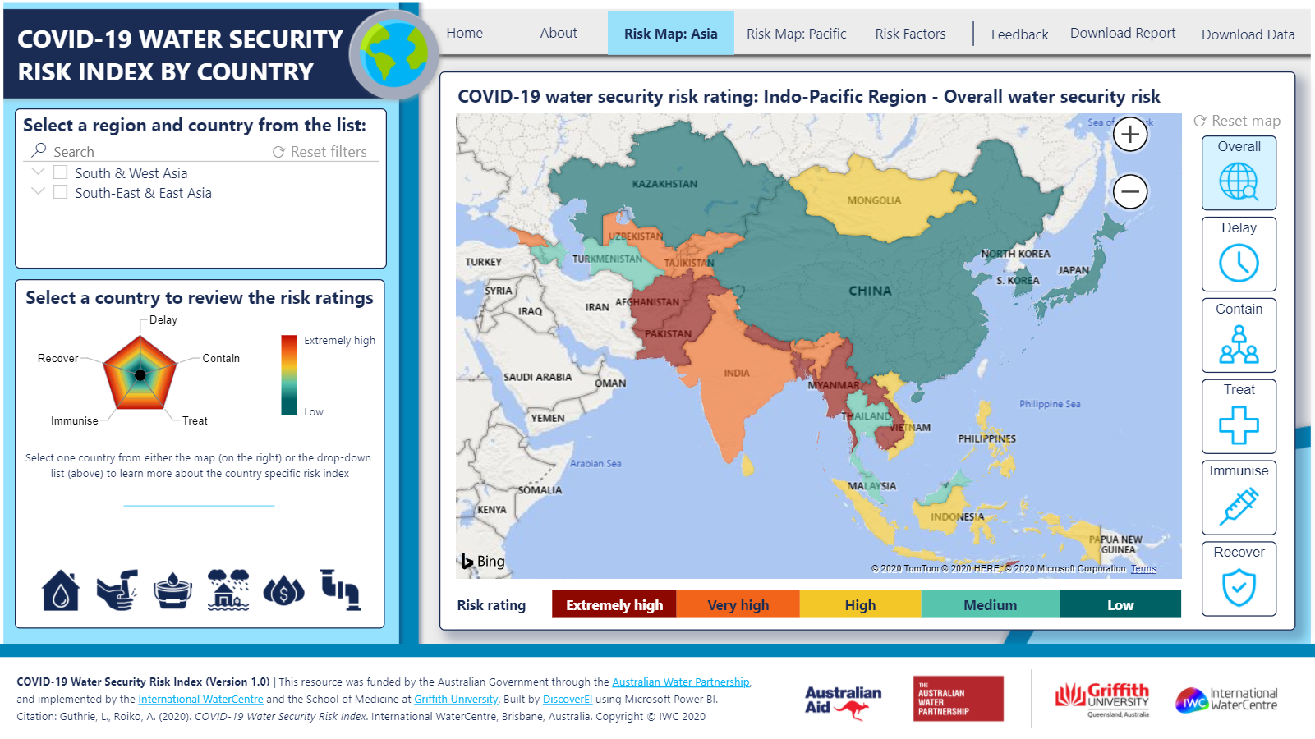
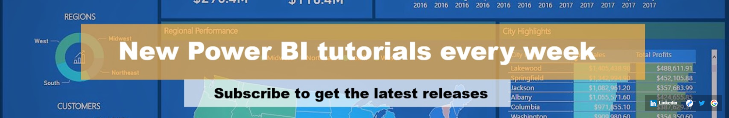
Some extra help:
Lots of online resources, a couple of my favorites are:
For tips, tricks & tutorials
Guy in a cube (youtube) https://www.youtube.com/channel/UCFp1vaKzpfvoGai0vE5VJ0w
For environmental / water related dashboard design and inspiration
DiscoverEI (website & training) https://www.discoverei.com/
For finance & formulas
Enterprise DNA (youtube) https://www.youtube.com/channel/UCy2rBgj4M1tzK-urTZ28zcA

Slide 5

Before the dashboard comes the data (model)
What does your data look like?
What is a data model?
How do we get our data into a format that Power BI* will like?
How do we link it all together?
Name Table
Date Table
BI* = Business Intelligence

Slide 6
Connecting to your data

Slide 7
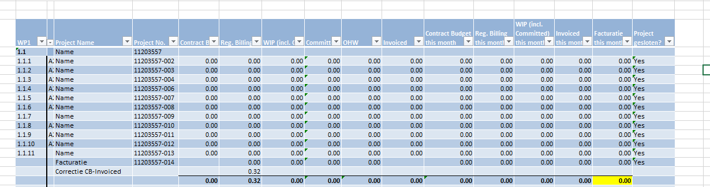
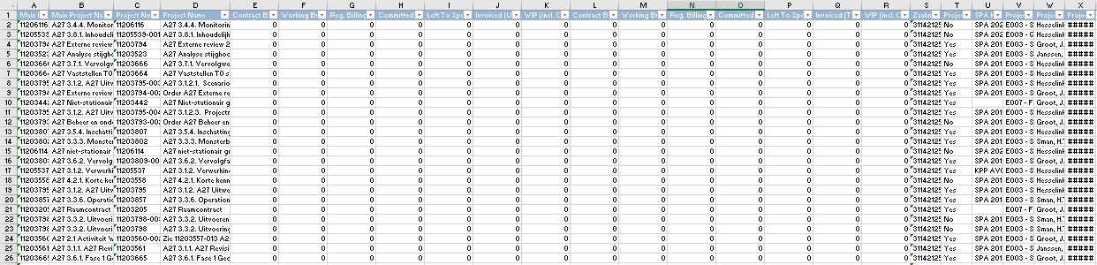
What does your data look like?
Structured (Tidy) vs Unstructured

Slide 8
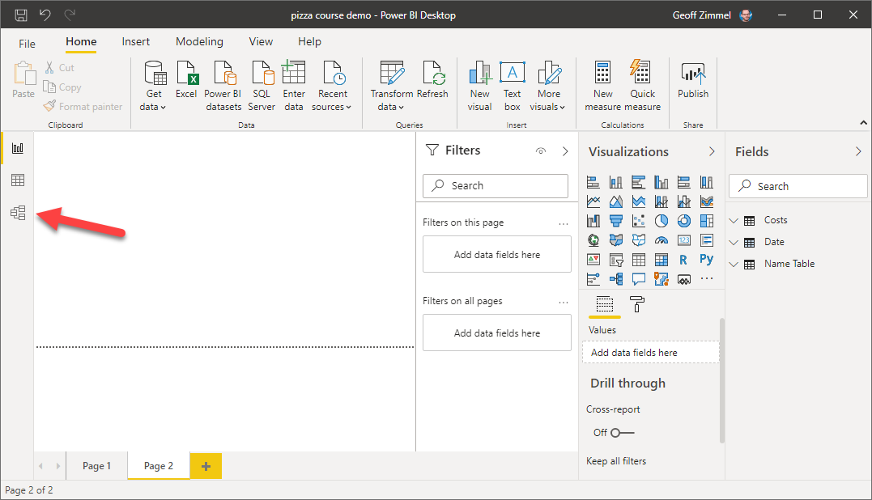
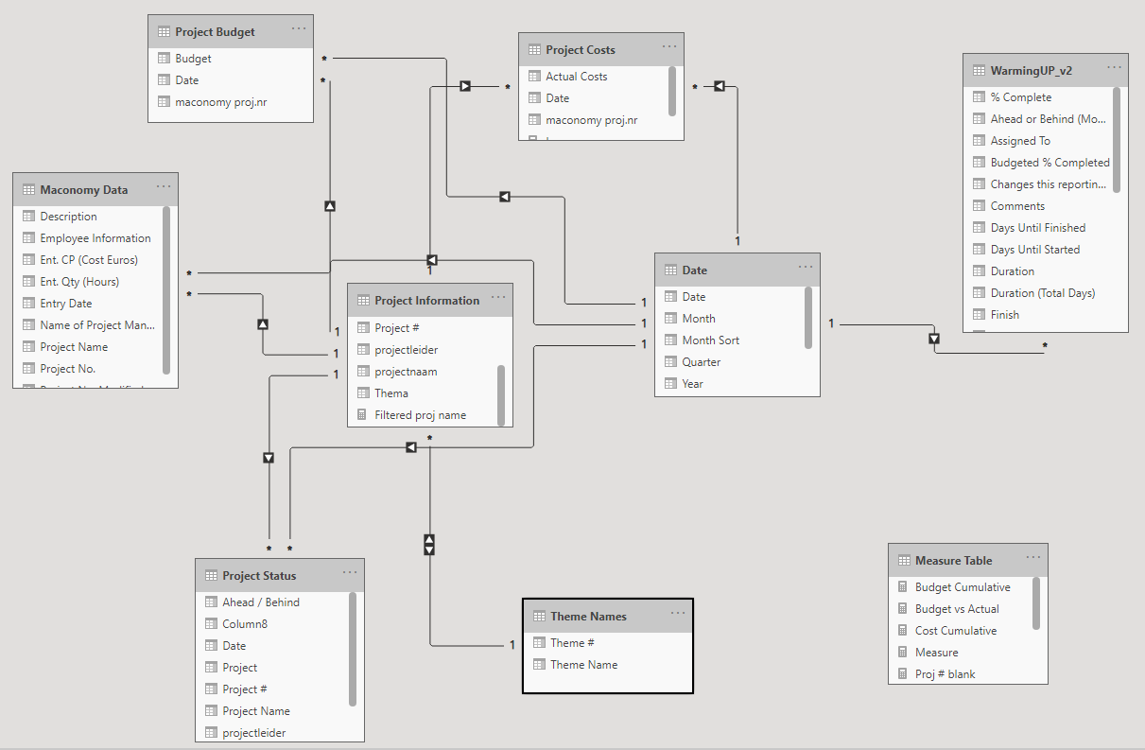
What is a data model / relational database?

Slide 9
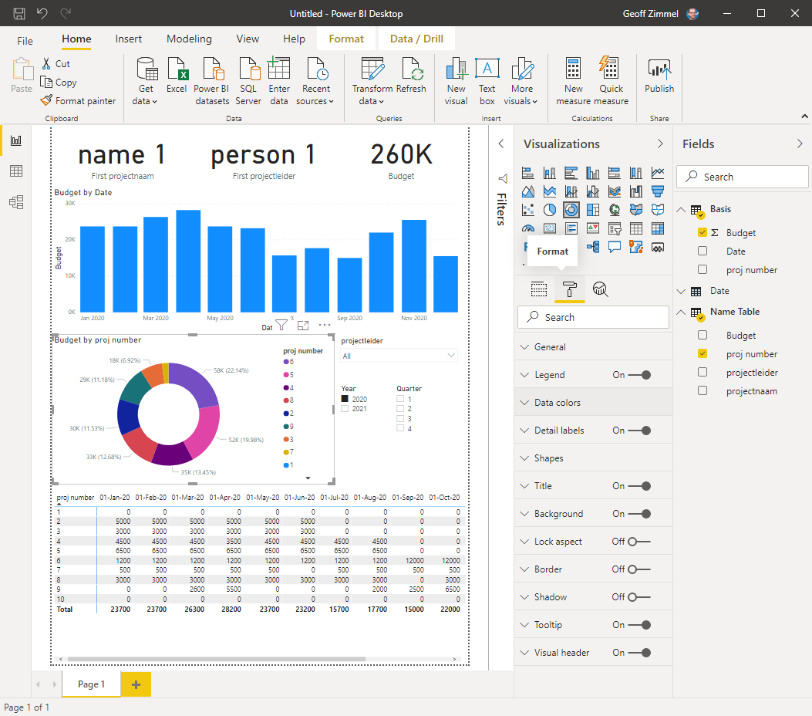
Exercise 1
Learning outcomes
Know how to import a dataset into Power BI
Understand some basic concepts in Power Query
Create a Name table
Create a Date table
Learn why Name and Date tables are a good idea
Connect Datasets
Generate a basic Power BI report
Dataset used:
n:\Deltabox\Postbox\Zimmel, Geoff\pizza course\pizza course\DEMO 1 cost planning.xlsx

Slide 10
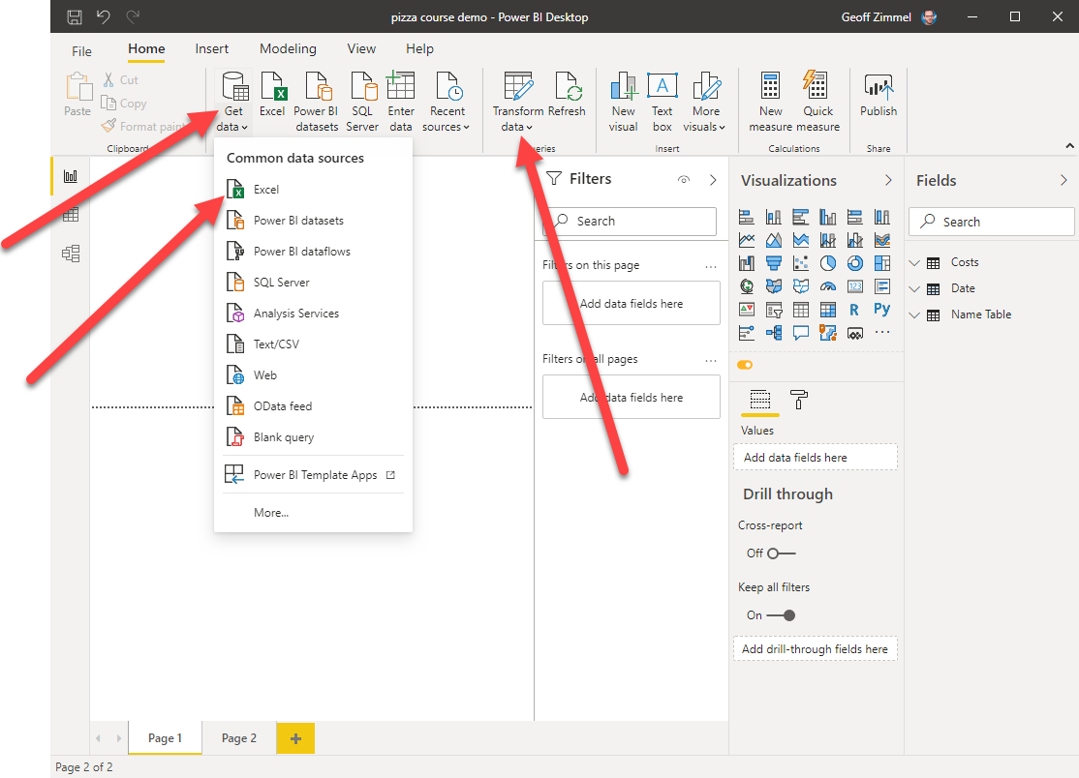
Getting data into a format that Power BI will like
1. Import new data
2. Transform existing data

Slide 11
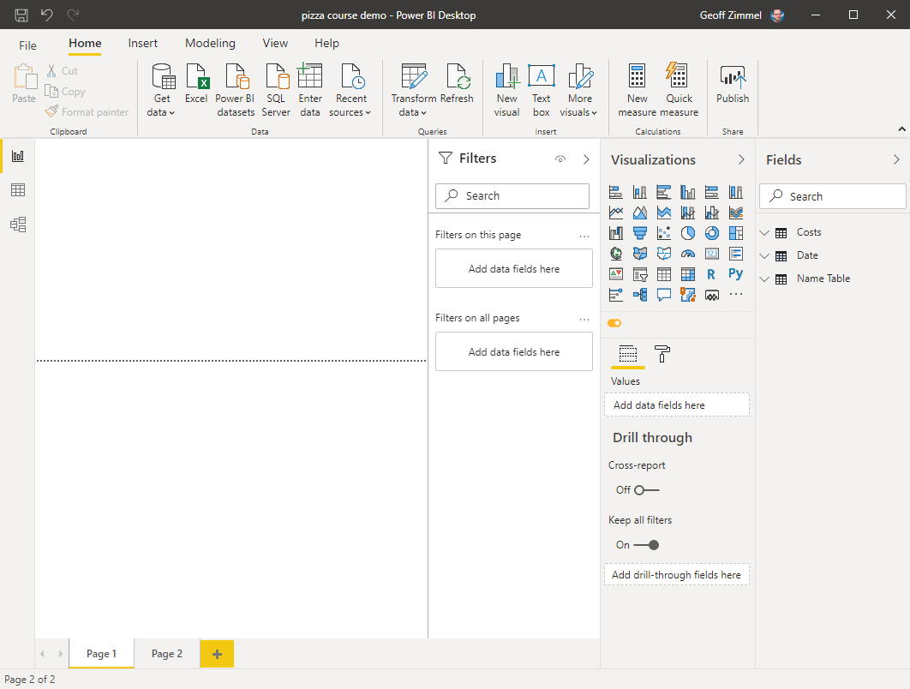
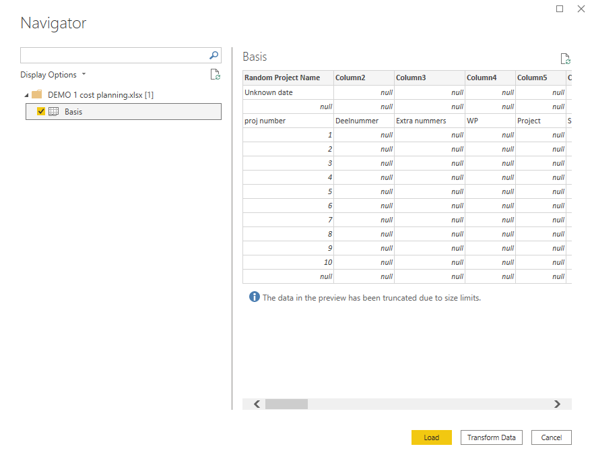
Getting data into a format that Power BI will like
Get Data
Select data type
Select file location
Select sheet within file
Click “transform data”
Voila – Welcome to Power Query

Slide 12
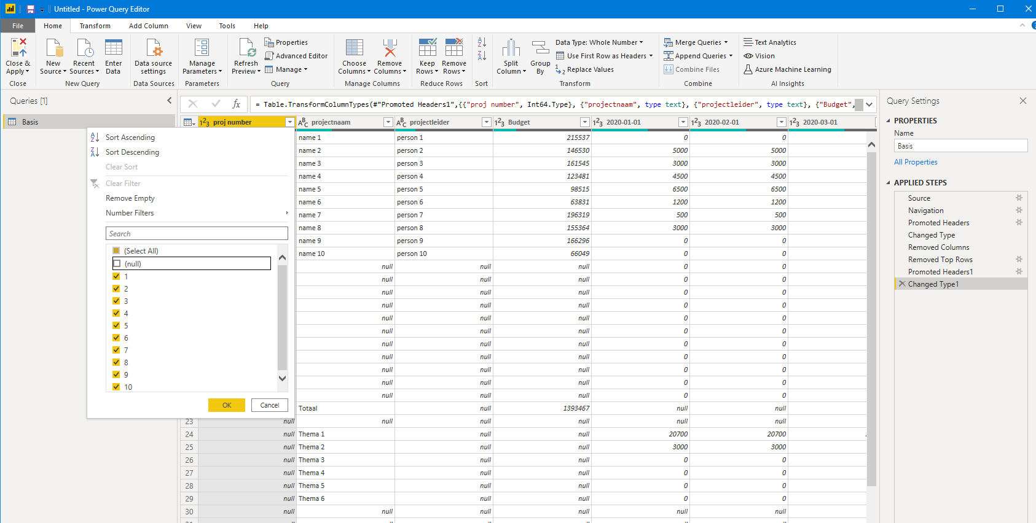
Getting data into a format that Power BI will like
Take a look at the dataset in Excel
Enter Power Query
Highlight & remove unwanted columns (2,3,4,5,6,10,35)
Remove top two rows (2)
Use first row as header
Remove bottom rows with filter.
Highlight “proj number” column
Click arrow in header
Uncheck “null”

Slide 13
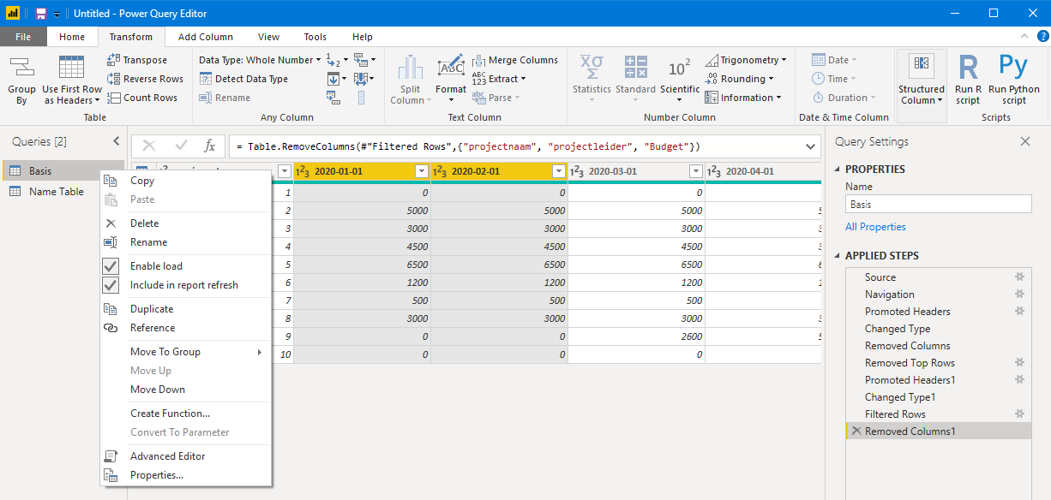
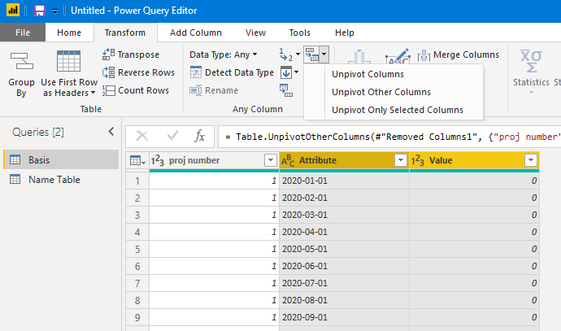
Getting data into a format that Power BI will like
Duplicate the Query
Right click “Basis”
Select “Duplicate”
Rename second Query “Name Table”
Now we will modify the “Basis” table:
Click on “Basis” in the Queries section
Remove columns
Highlight columns named
“Projnaam”
“Projectleider”
“Budget”
Select Remove columns
Transform table
Highlight all date columns
Select “Unpivot columns”

Slide 14
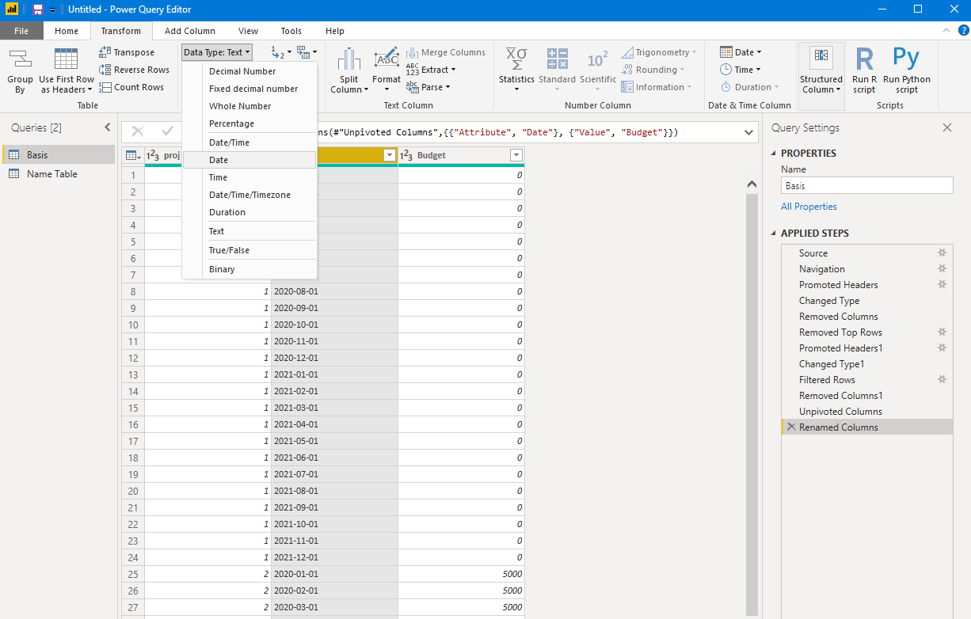
Getting data into a format that Power BI will like
Rename “Attribute” → “Date”
Rename “Value” → “Budget”
Change Date type to Date

Slide 15
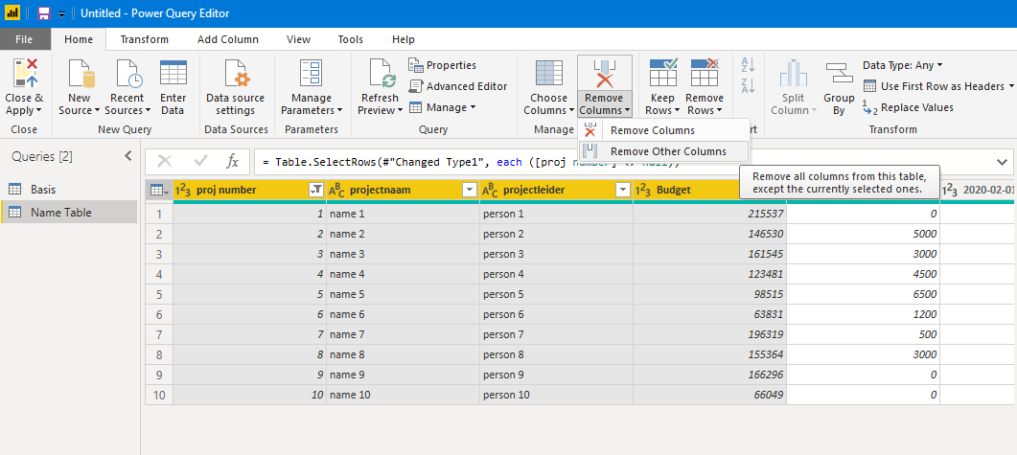
Getting data into a format that Power BI will like
Now we will modify the “Name Table” table:
Click on “Name Table” in the Queries section
Remove columns
Highlight
“Proj number”
“Projnaam”
“Projectleider”
“Budget”
Select Remove Other Columns
Select “Close and Apply” to exit

Slide 16
Date & Name Tables
Date Table
A way to join multiple datasets on a specified column
A date table does not have repeating dates (1) but can join with tables that have many dates (*)
This table is then used as a filter instead of the date column in a specific sheet
No longer have to link each table together, simplifying the data model
For our example it is not really needed but is good practice and good to understand

Slide 17
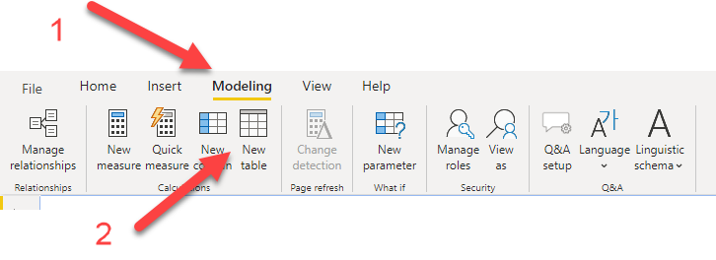
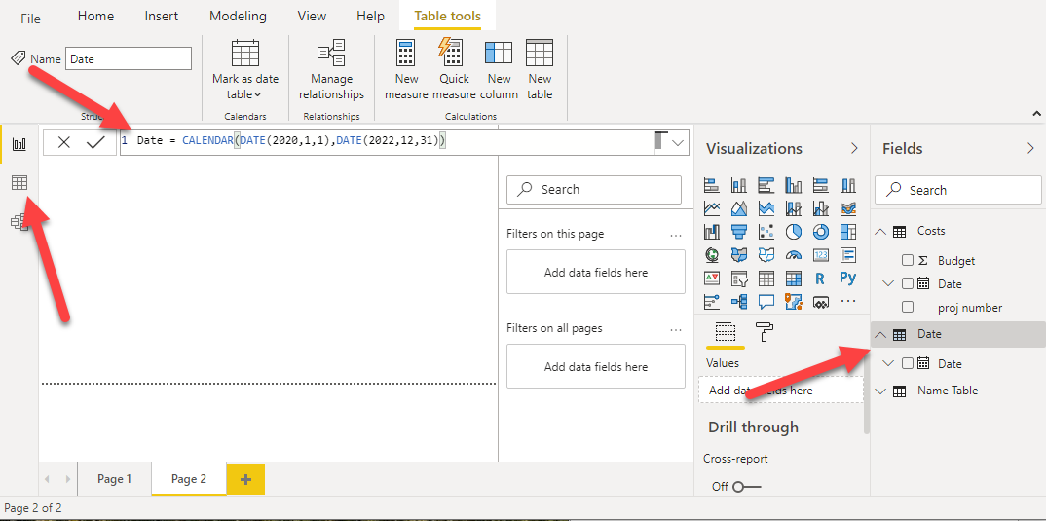
Date Tables
Steps to generate a date table:
Create a new table (1,2)
In the formula bar copy and past the expression:
Date = CALENDAR (DATE(2020,1,1),DATE(2022,12,31))
This will update the table name & generate a date rage. Go to the table view to see what it looks like

Slide 18
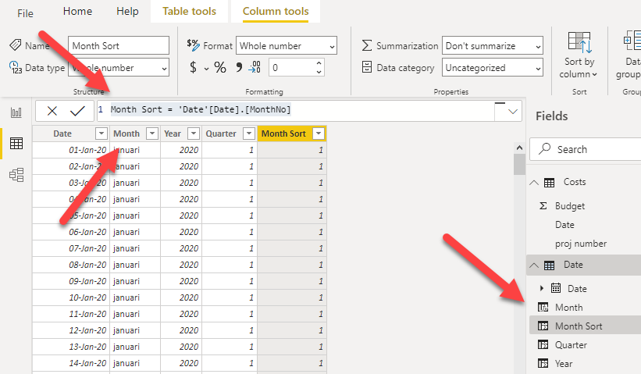
Date Tables
Date Table
Colum tool to change the data type
Format to change the style/format
Searching and ordering by month or year. Create new columns
Create new column(s) – right click, new column
Month = 'Date'[Date].[Maand]
Year = 'Date'[Date].[Jaar]
Quarter = 'Date'[Date].[QuarterNo]
Month Sort = 'Date'[Date].[MonthNo]

Slide 19
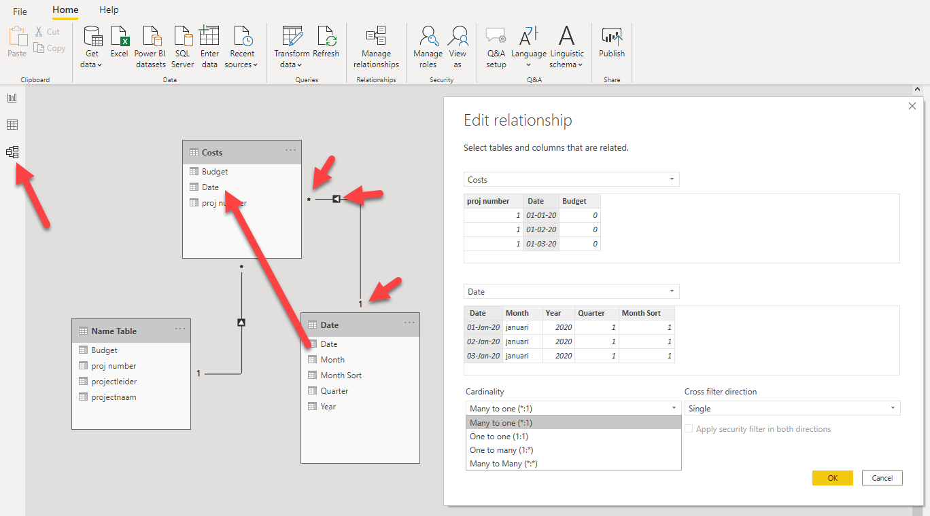
Date Tables
Join the date table
Go to the model tab on the left
Sometimes it will connect automatically, if not;
Click and drag ‘Date’[Date] → ‘Basis’[Date]
Notice the symbols
* = many
1 = one
Black arrow shows the direction
Right click the connection line to edit and see properties
UNDERSTAND THE TYPES OF RELATIONSHIPS BEFORE SELECTING

Slide 20
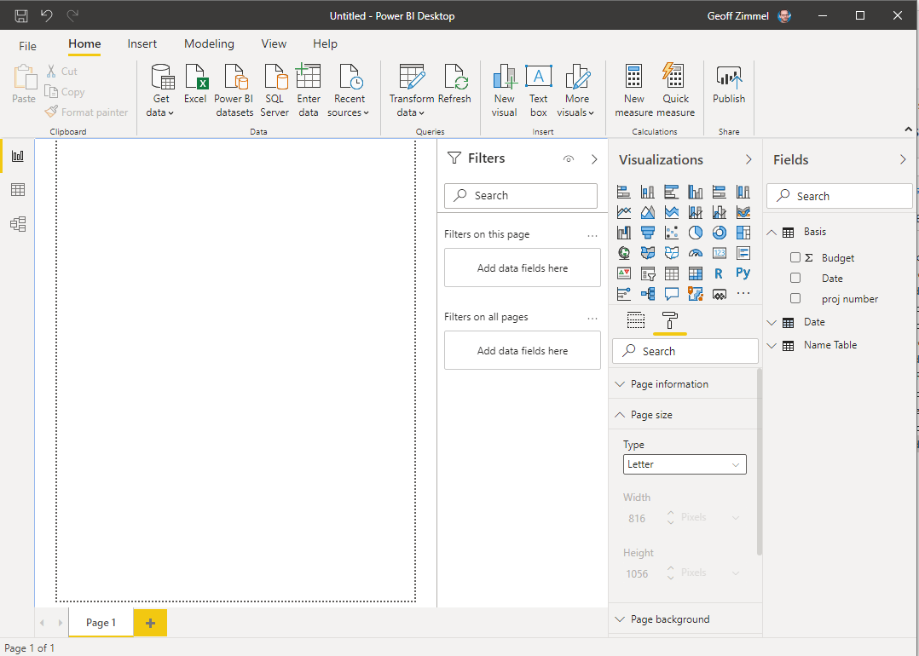
Building the Report
Select the page layout you want
We will use “letter”
Time to get creative… What does the user want to see? We will add some basics:
Bar chart
Cards
Pie Chart
Slicers
Matrix table

Slide 21
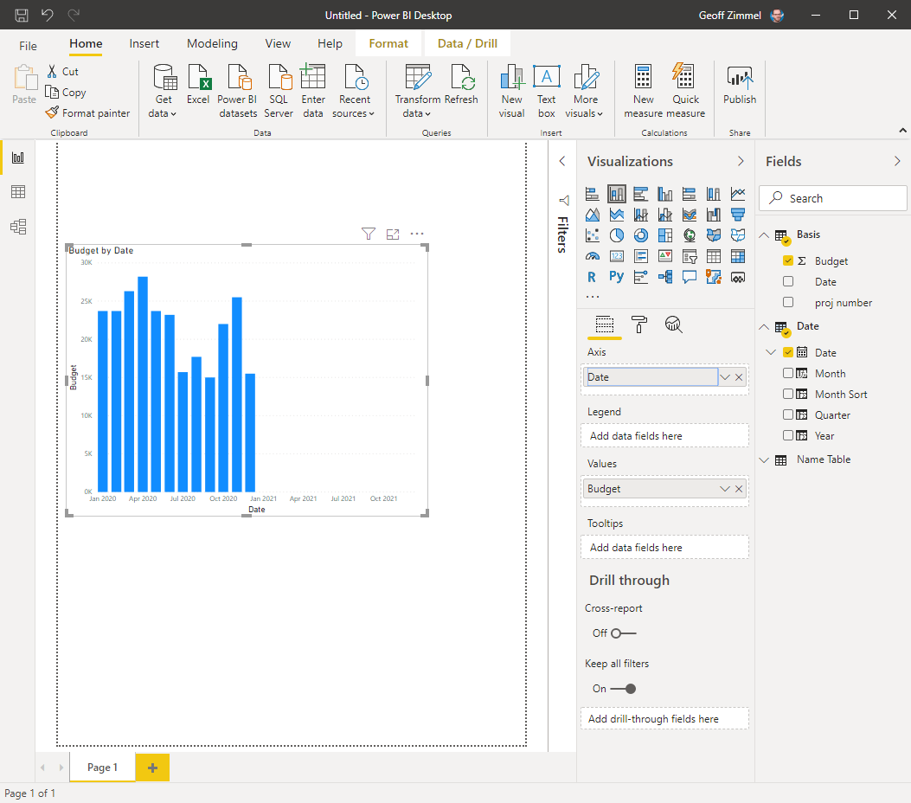
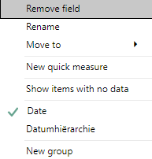
Add a bar chart
Select the “stacked column chart” visualization
Drag “budget” → values opening
Drag “date” → axis opening
Unselect date hiarchy
Right click date
Select “date”
Be aware of any aggregation that are occurring (right click on “budget” to see the options)

Slide 22
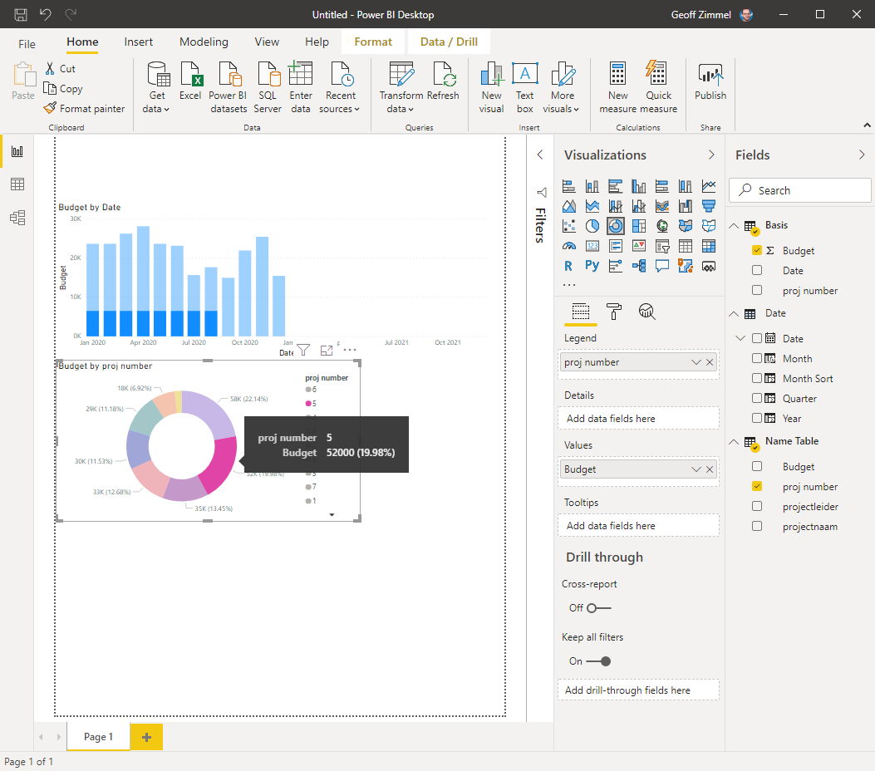
Add a pie / donut chart
Select the “donut chart” visualization
Drag “budget” → values opening
Drag “proj number” → legend opening
Now we can check the connections in our data model by selecting a section of the donut chart

Slide 23
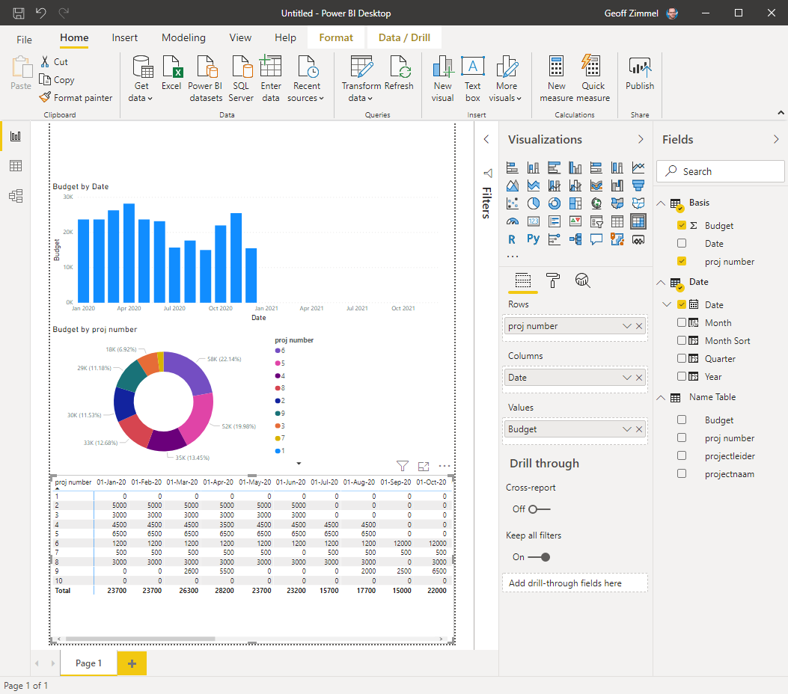
Add a matrix table
Select the “matrix table” visualization
Drag “budget” → values opening
Drag “proj number” → rows opening
Drag “Date” → Columns opening
Right click and select “date”
Check the column sort function by clicking on the header
Change the aggregation type to show something different in the “total” column and within the table itself (i.e min, max, avg, ect)

Slide 24
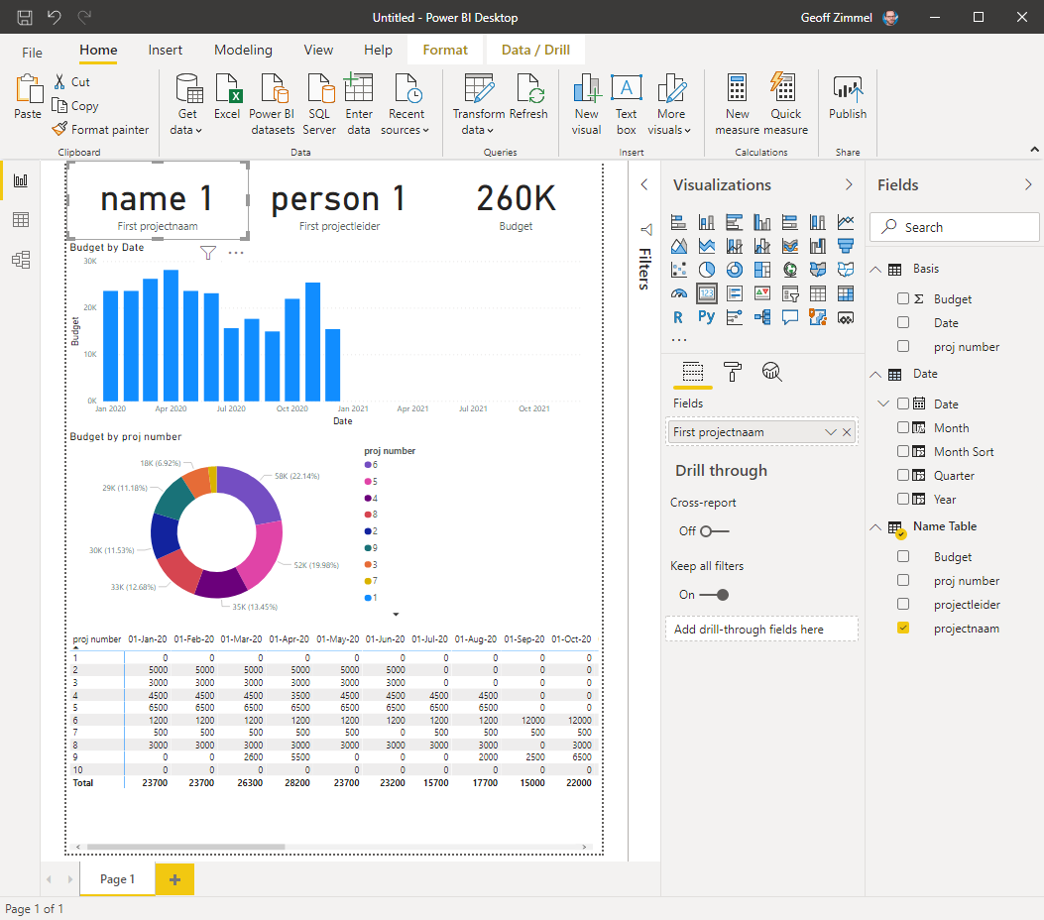
Add a card
Select the “card” visualization (one card for each of the following):
Drag “projectleider” → fields opening
Drag “projectnaam” → fields opening
Drag “budget” → fields opening
Check the column sort function by clicking on the header
Change the aggregation type to show something different in the “total” column and within the table itself (i.e min, max, avg, ect)

Slide 25
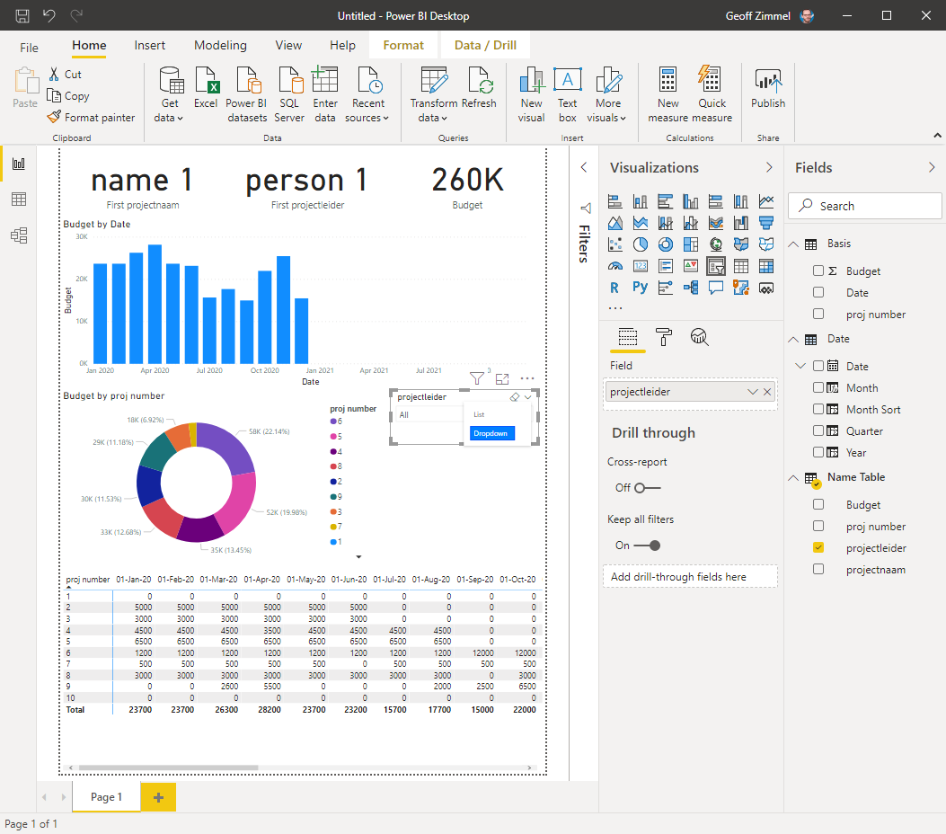
Add a Slicer
Select the “slicer” visualization (one slicer for each of the following):
Drag “projectnaam” → field opening
Change to dropdown in the corner of the visual
Drag “year” → field opening
Change to “list” from dropdown
Drag “Quarter” → field opening

Slide 26
Customize the visuals
Congrats! You made it!
Change the way visuals interact with each other by selecting a visual, click the “format” tab, click “edit interactions”
Change colors, text size, font, titles, and a lot more within the “Format” tab
Make sure the data tells a story.
Less is more.

Slide 27
Reminder of extra help:
Lots of online resources, a couple of my favorites are:
For tips, tricks & tutorials
Guy in a cube (youtube) https://www.youtube.com/channel/UCFp1vaKzpfvoGai0vE5VJ0w
For environmental / water related dashboard design and inspiration
DiscoverEI (website & training) https://www.discoverei.com/
For finance & formulas
Enterprise DNA (youtube) https://www.youtube.com/channel/UCy2rBgj4M1tzK-urTZ28zcA

